Slide 1
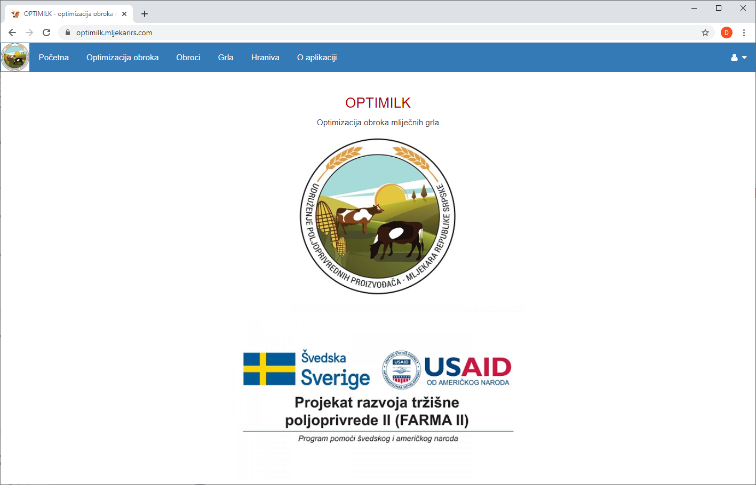
Meal optimization for dairy cows - OPTIMILK-
Mostar, 05.10.2020.
Miljan Erbez, PhD

Slide 2
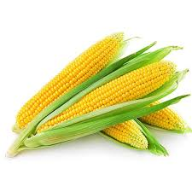
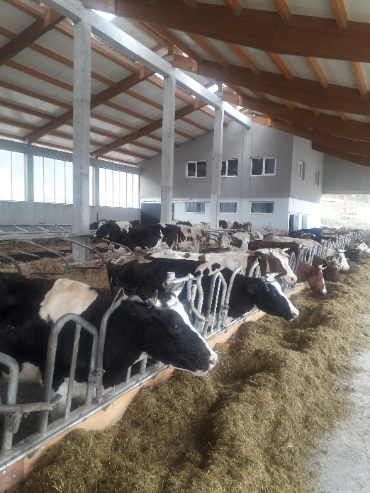
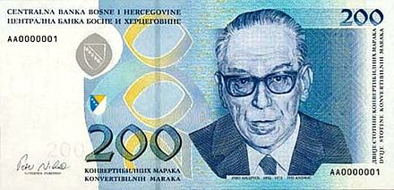
Feeding costs
Feeding costs
The most significant component in
milk production!

Slide 3
What does it mean when say to optimize the meal for dairy cow?
Optimization - finding the best solution according to a certain criterion
Find the optimal structure of nutrients
Satisfy all the needs of the animal (dairy cow)
Provide minimum feeding costs

Slide 4
Traditional vs modern methods
Pearson's square
Linear programming
Nonlinear programming
Targeted programming ...
Costs
Cost minimization

Slide 5
OPTIMILK
https://optimilk.mljekarirs.com
Science
(IT and Agri Sector)
Users
500 Dairy Farmers
DONORS

Slide 6
OPTIMILK - possibilities
Meal optimization
Meal recording
Nutrient base
Needs planning for a specific period of time
Animal records
Application user management

Slide 7
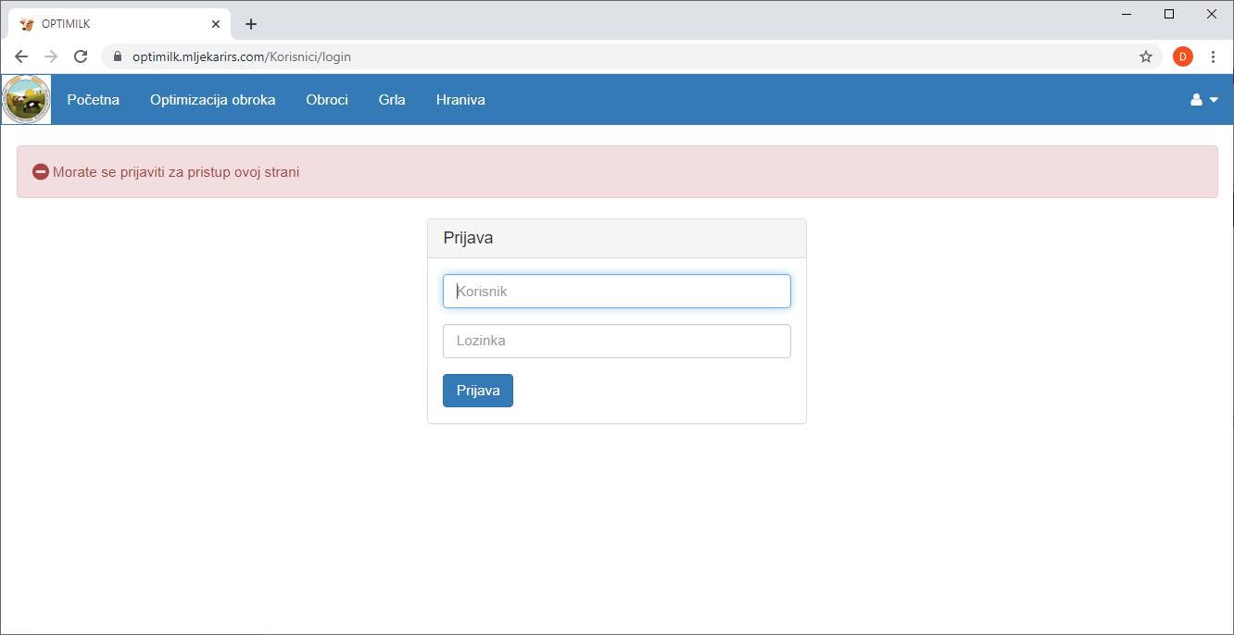
Login to the application

Slide 8
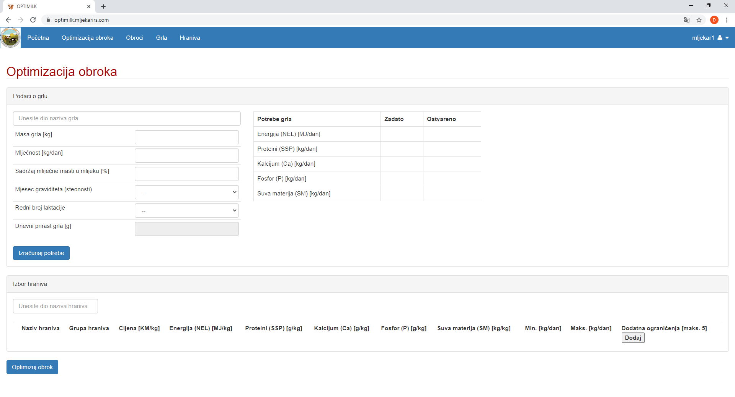
^{Simple user interface}
Menu
Animal parameters and needs
Feed choice

Slide 9
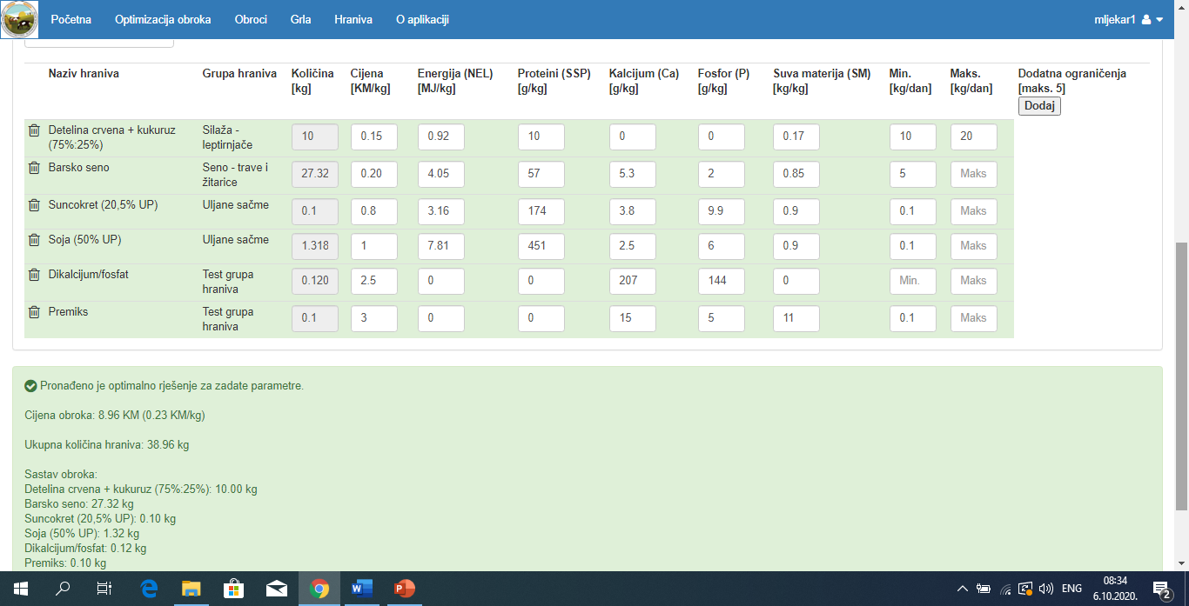
Results

Slide 10
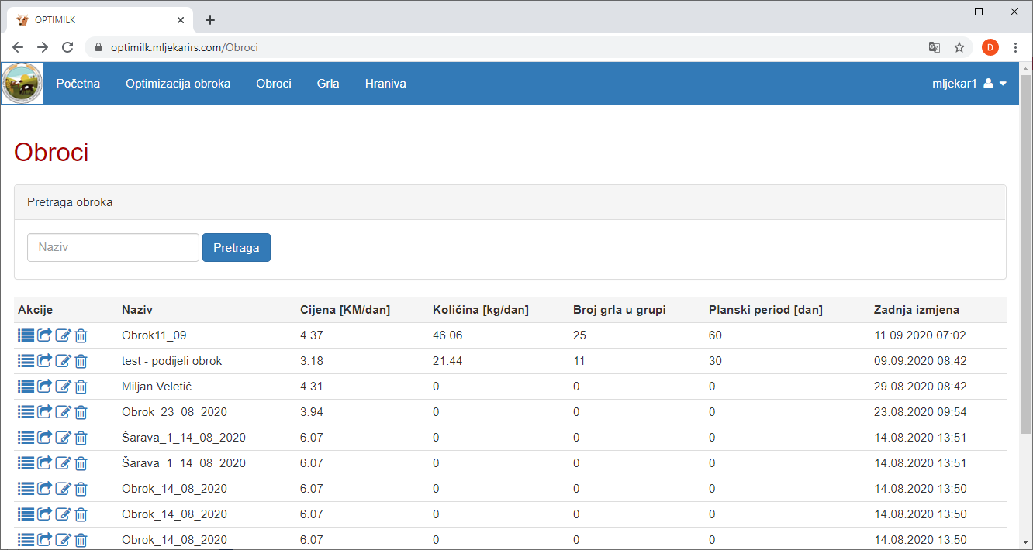
Snimljeni obroci

Slide 11
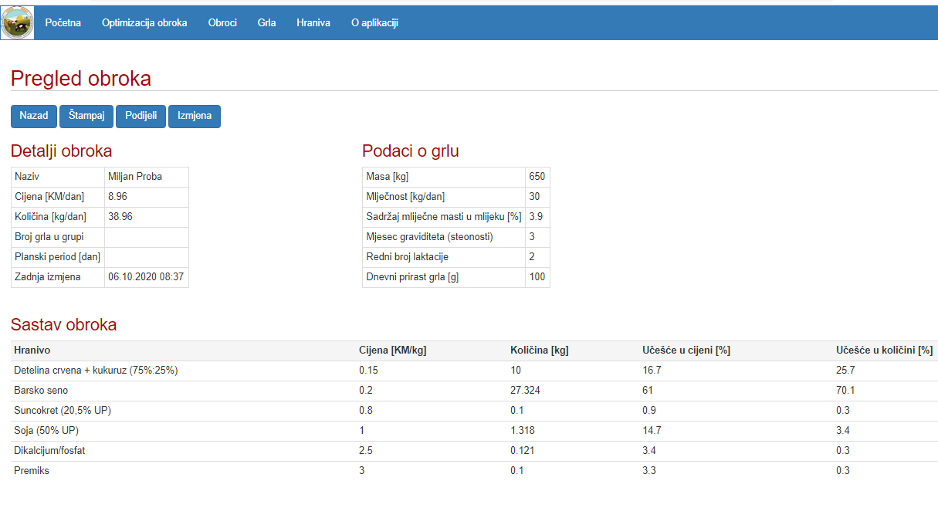
Meal overview

Slide 12
Printing the meal

Slide 13
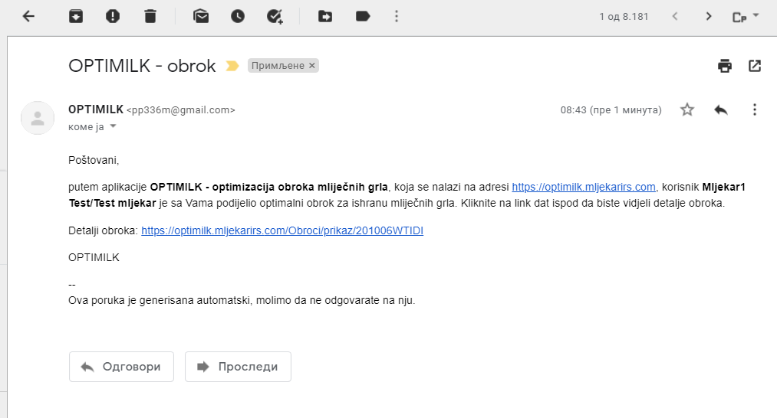
Share the meal

Slide 14
Thank you for your attention!
www.mljekarirs.com
www.farmabih.ba

