Slide 1
IT systems in Integrated Plant Production
– useful tool or need?
Mladen Zovko
The second workshop on ICT in Agriculture, Mostar, October 6th, 2020

Slide 2
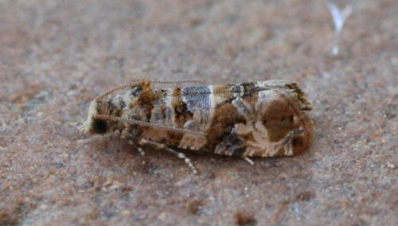
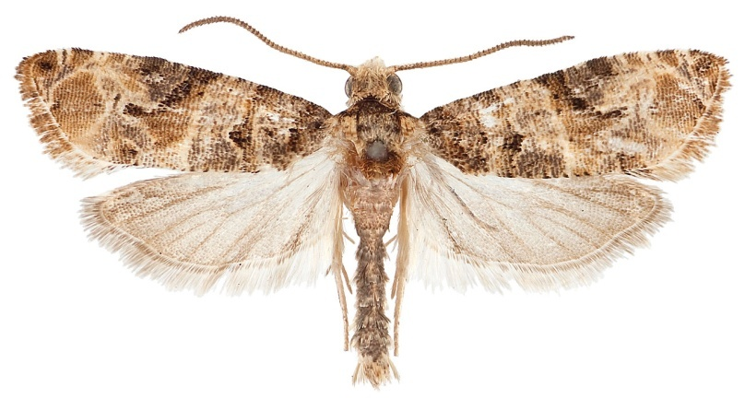
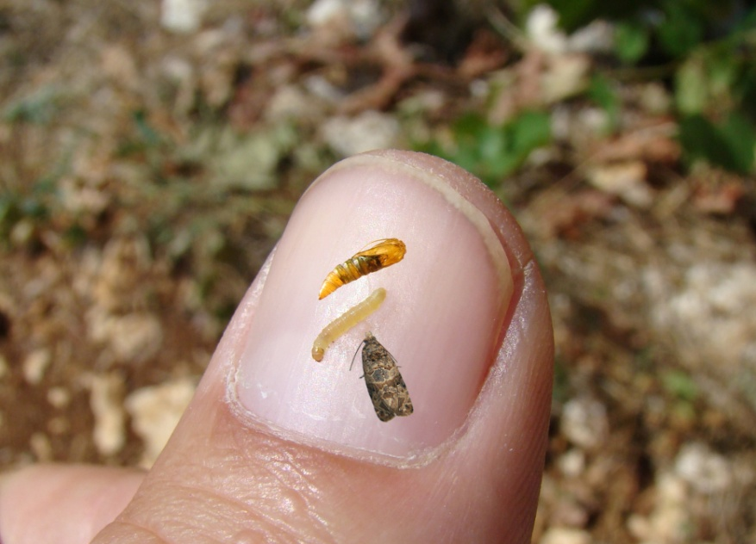
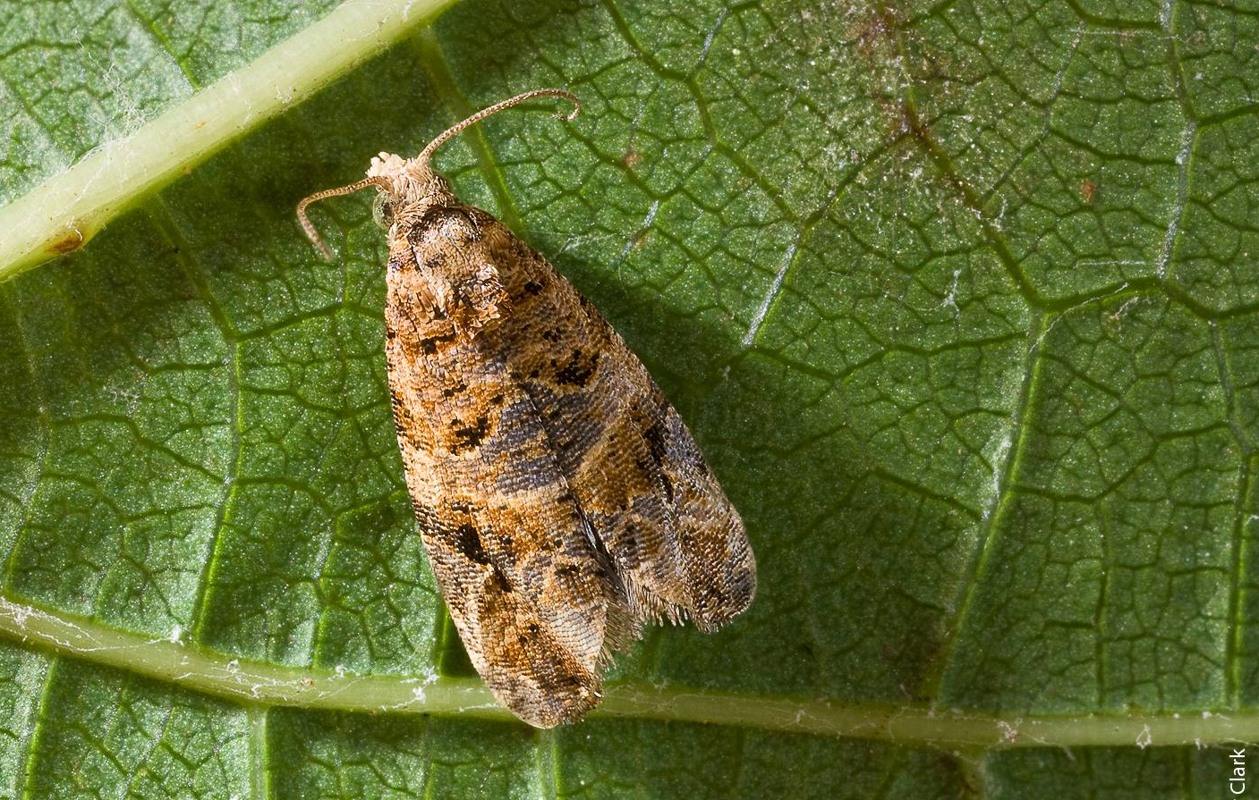
European grapevine moth (Lobesia botrana)
11-13 mm
6-8 mm

Slide 3
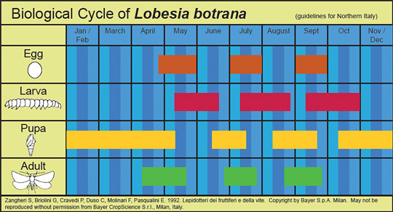

Slide 4
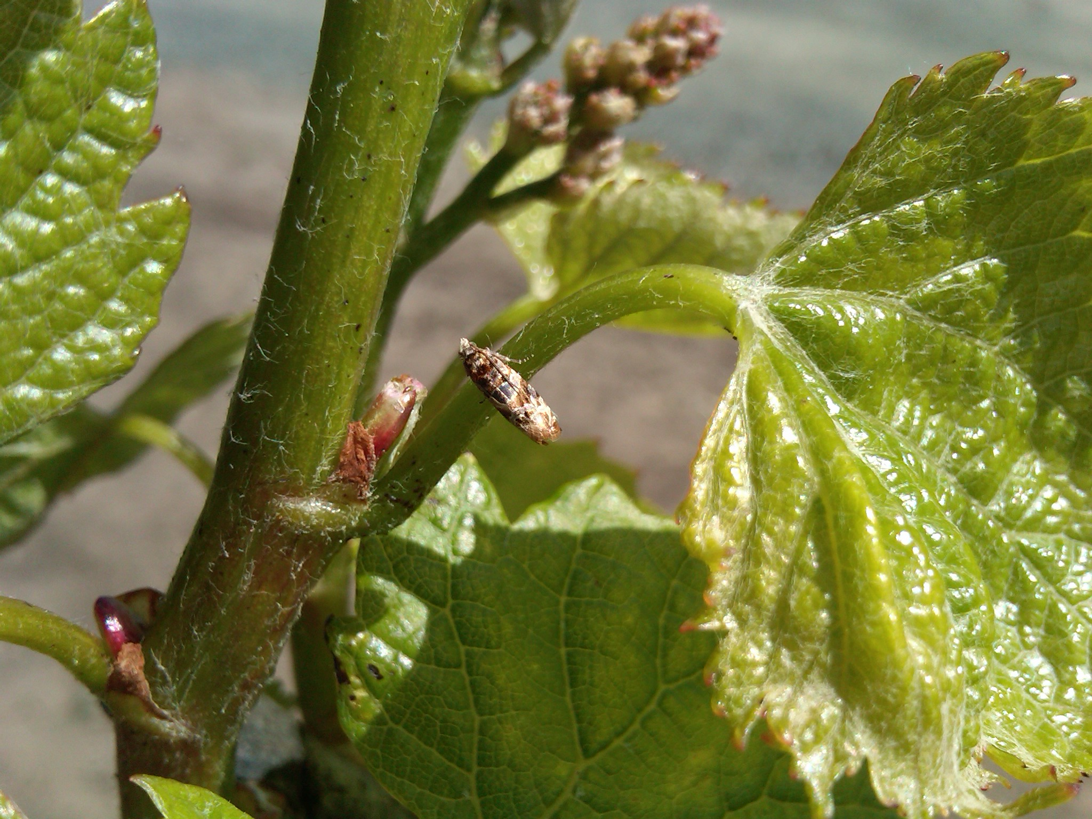
Adults of the first generation emerge when air temperatures exceed a threshold of (10°C) for a period of 10-12 days
Optimal conditions for moth activity are at tem. over 20-27˚C and at 40-70% relative humidity

Slide 5
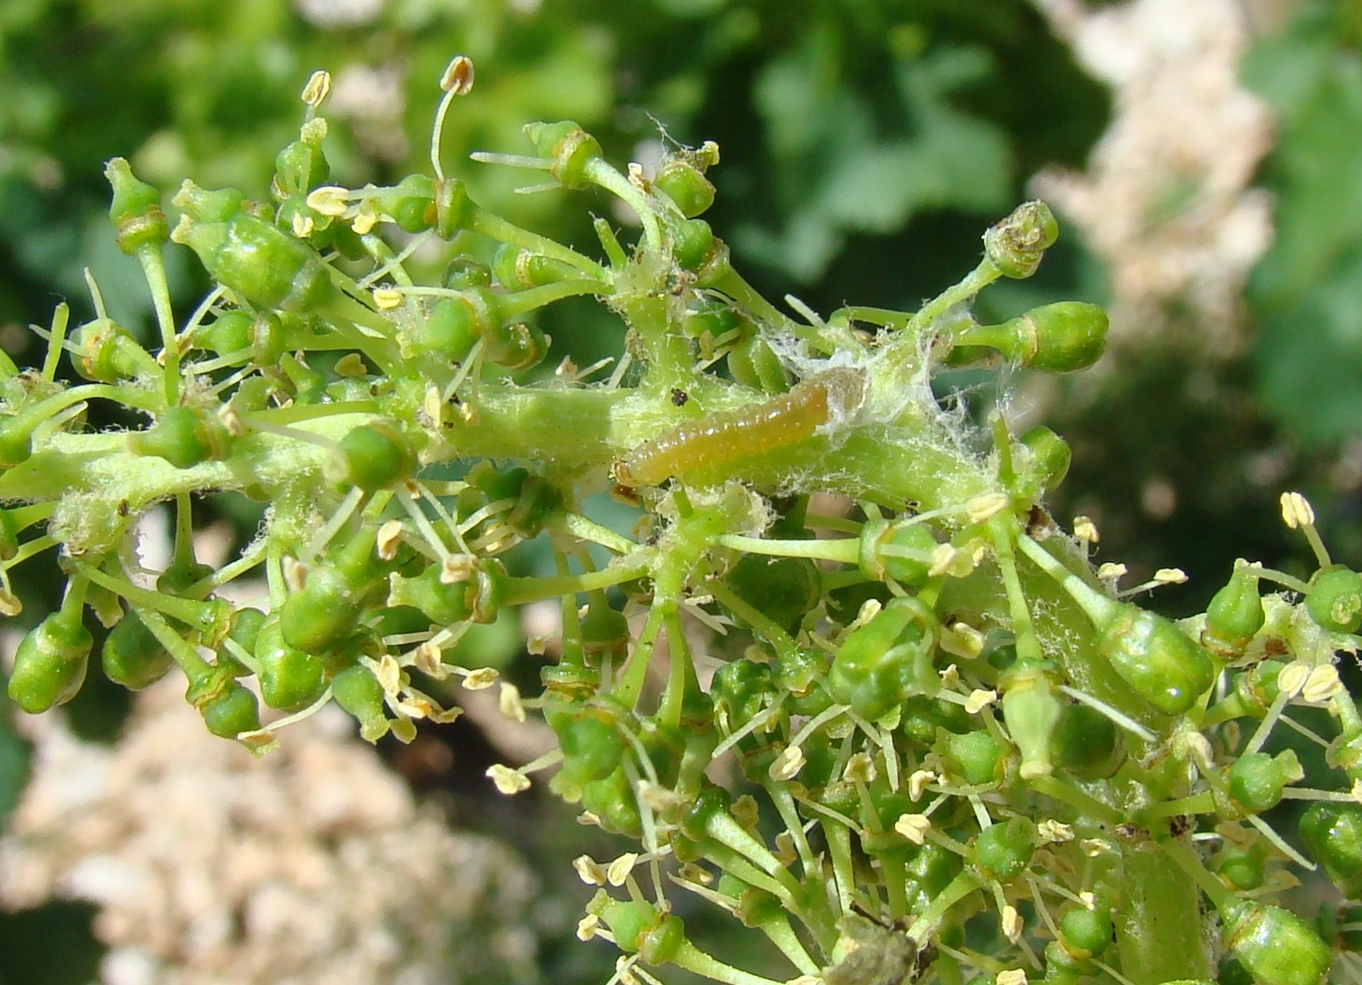
First generation larvae feed on the flower clusters

Slide 6
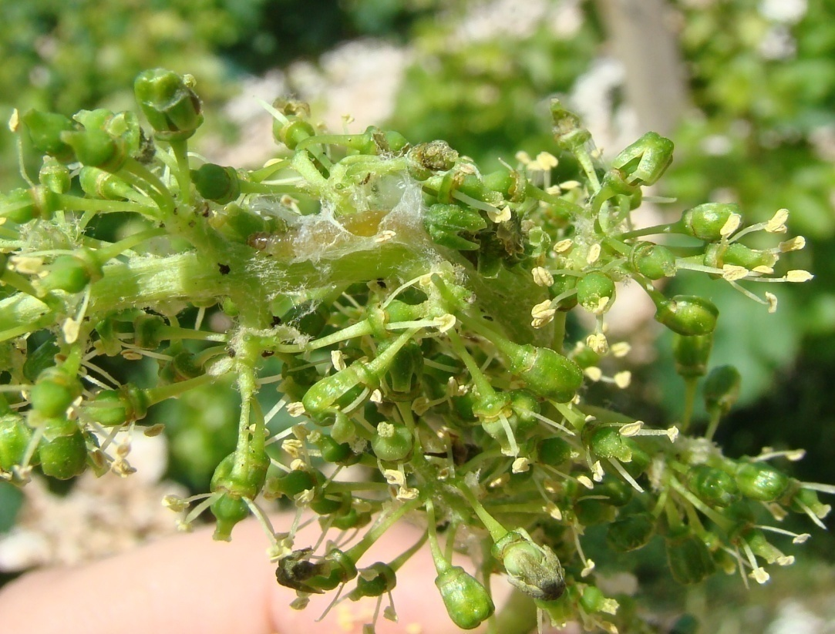
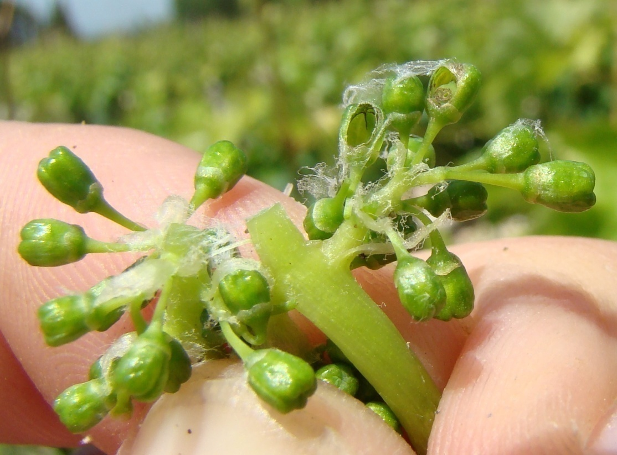
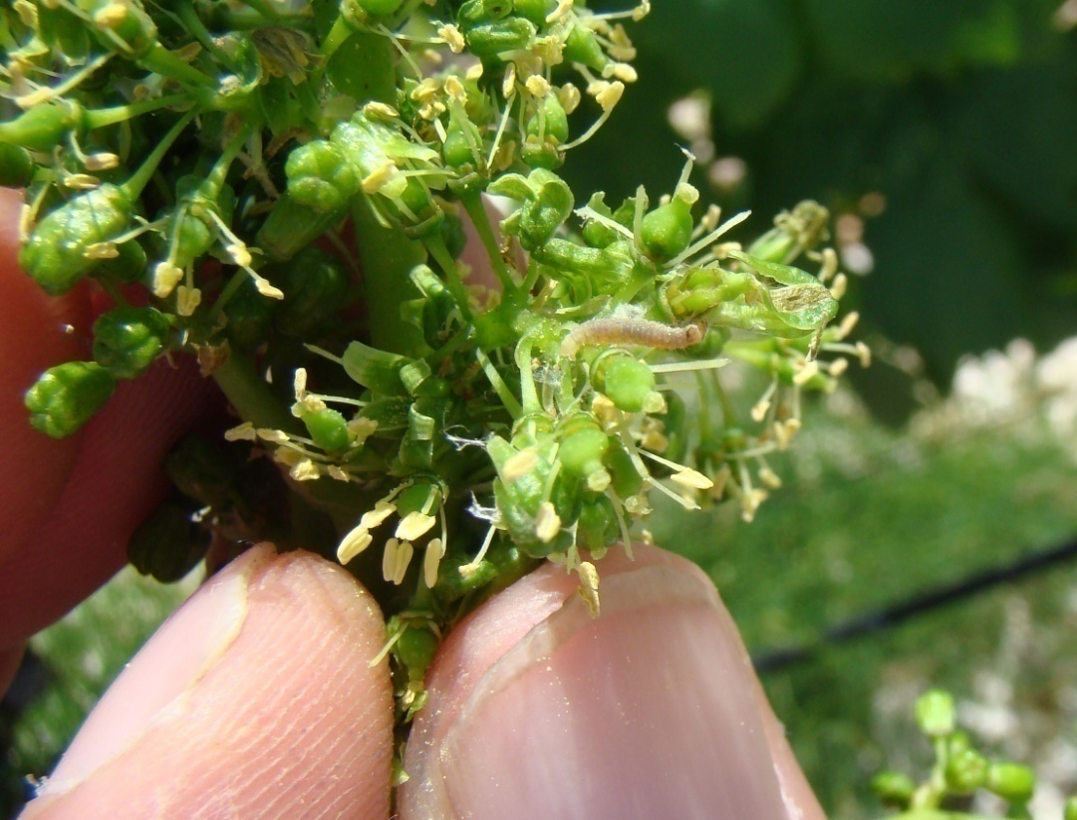
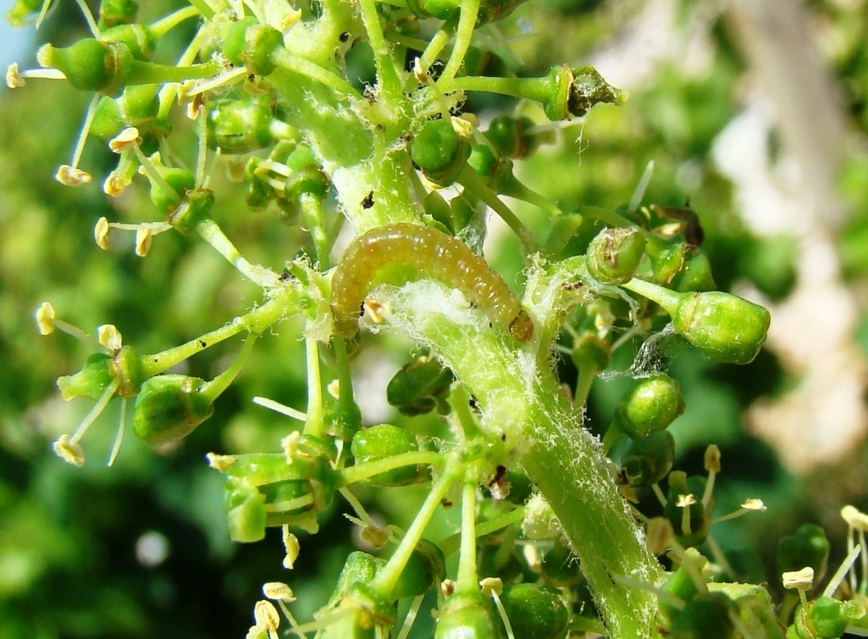
A single caterpillar can destroy even a dozen berries during its developement

Slide 7
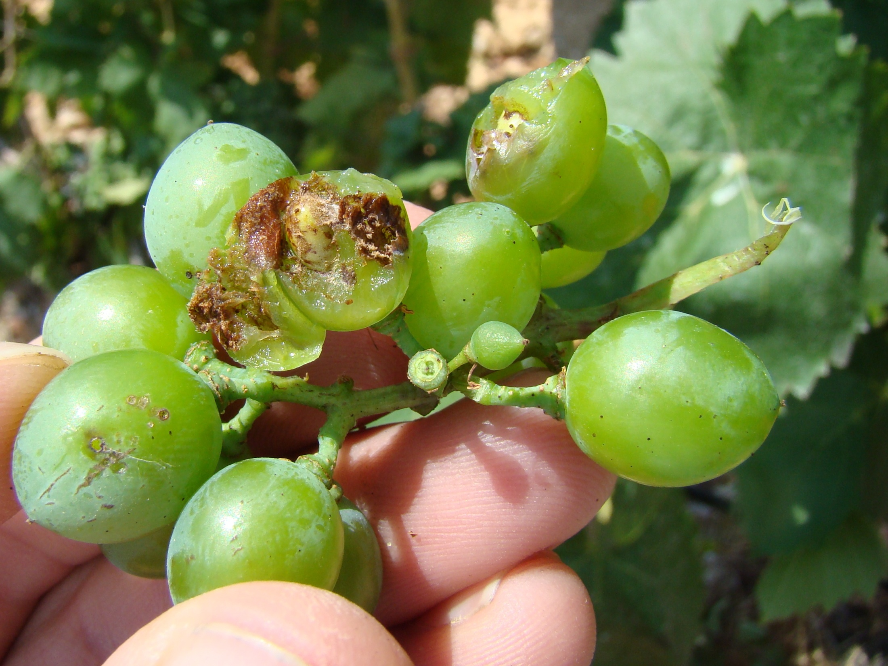
Damage of carpophagous generation

Slide 8
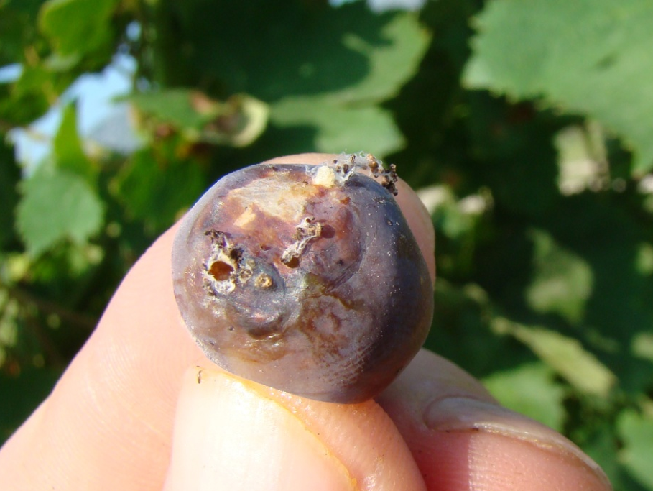
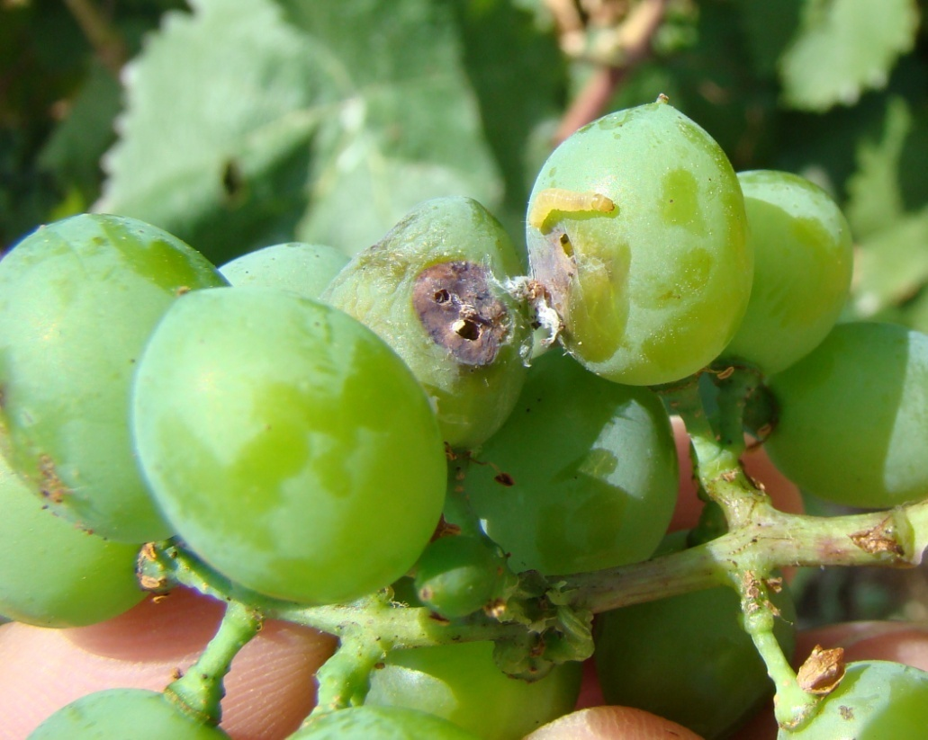
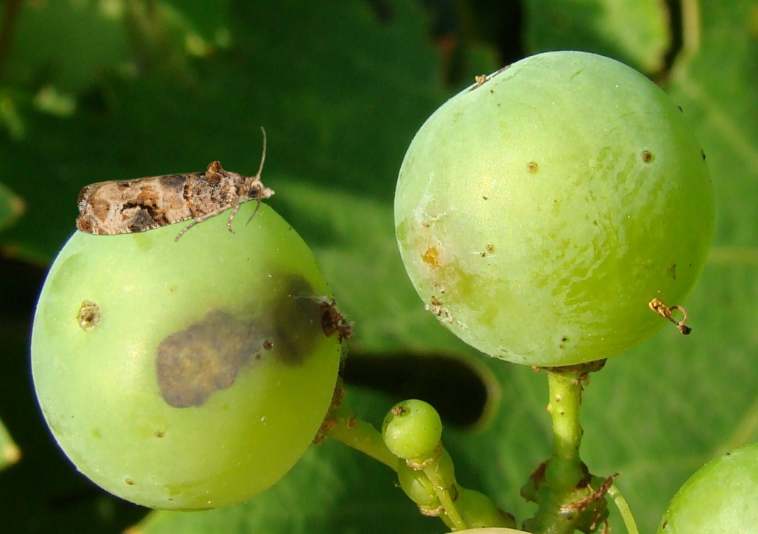
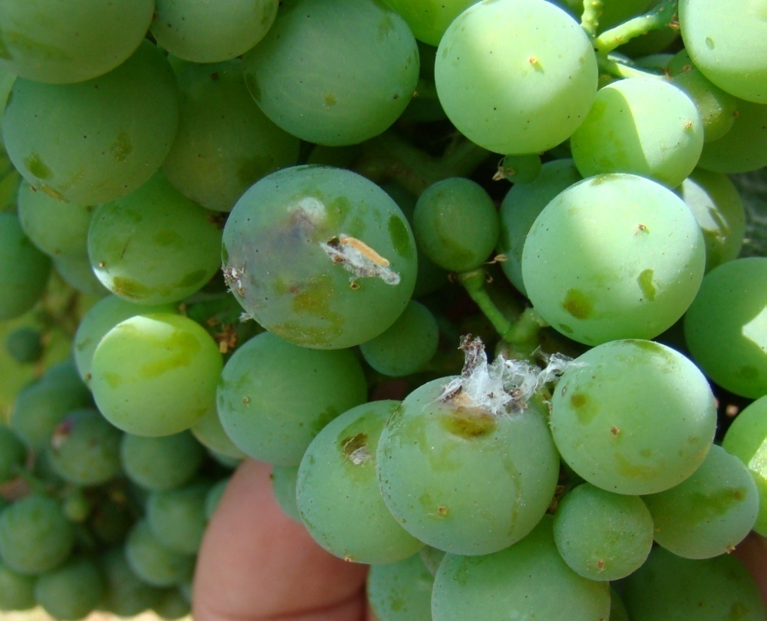
Second generation larvae feed on green berries

Slide 9
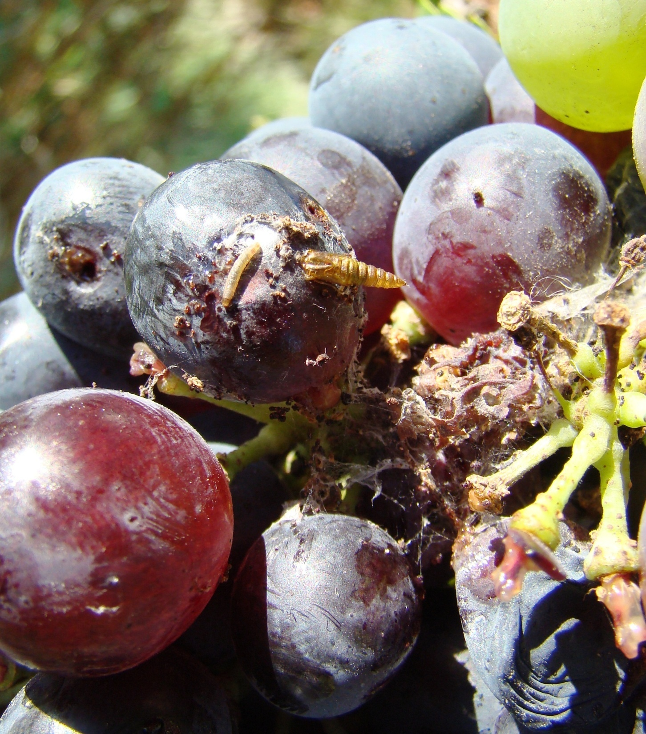
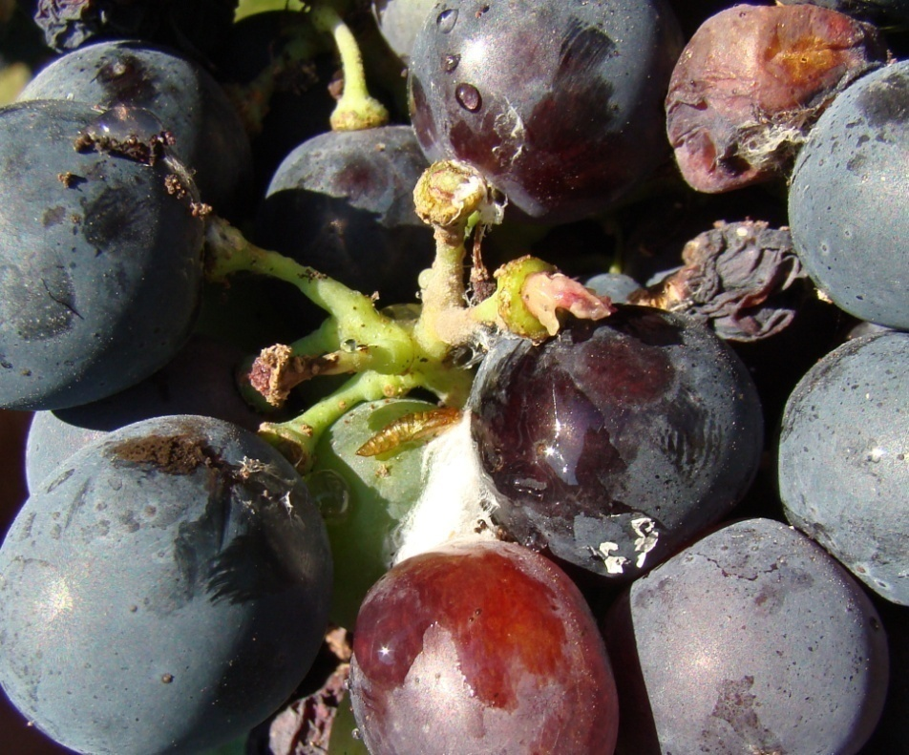
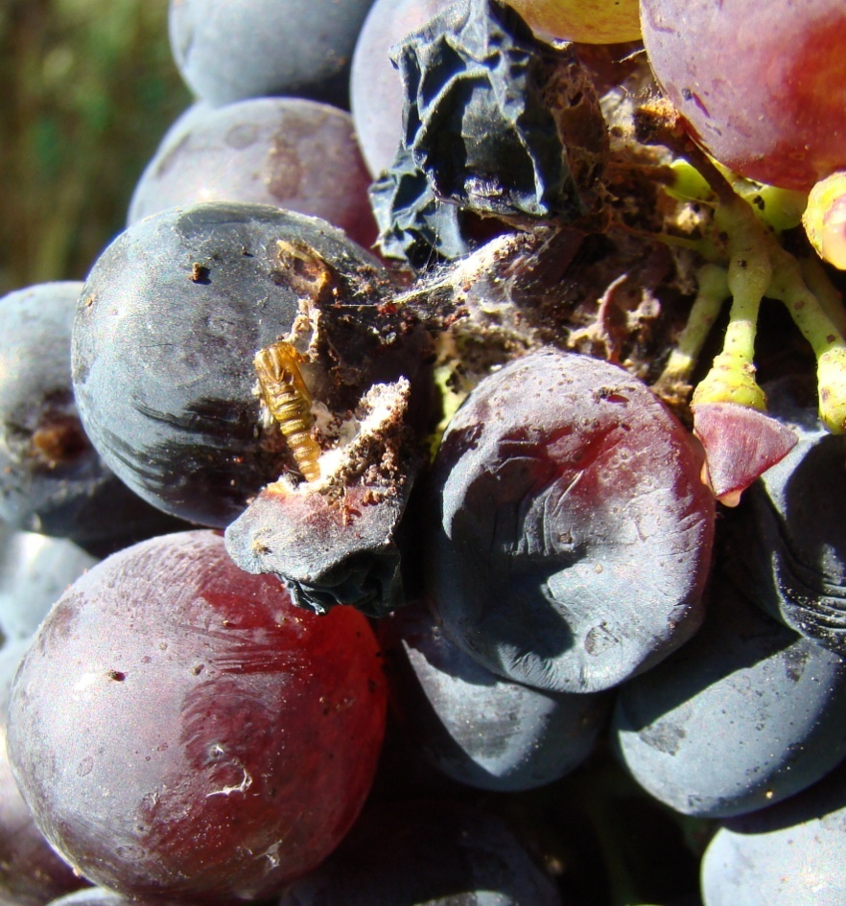
Damage of carpophagous generation on ripen berries

Slide 10
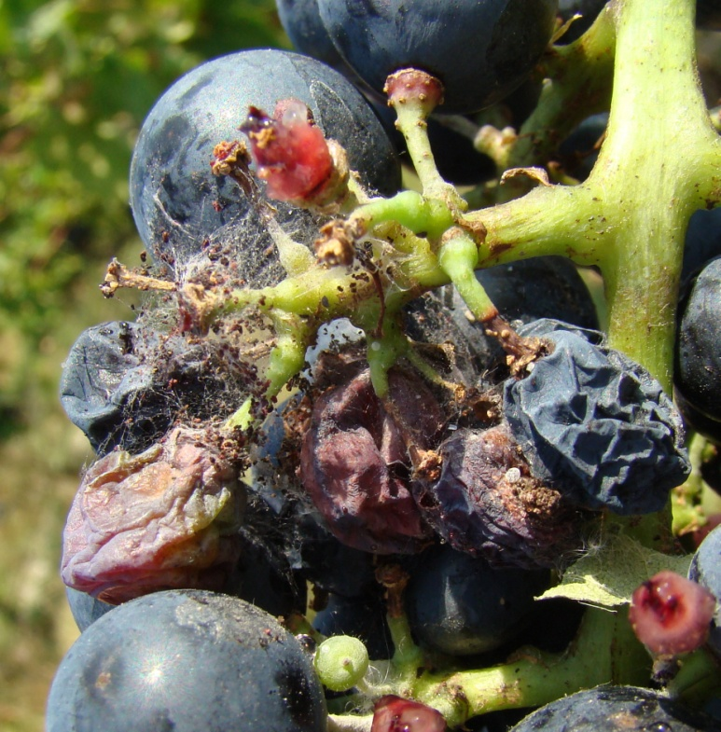
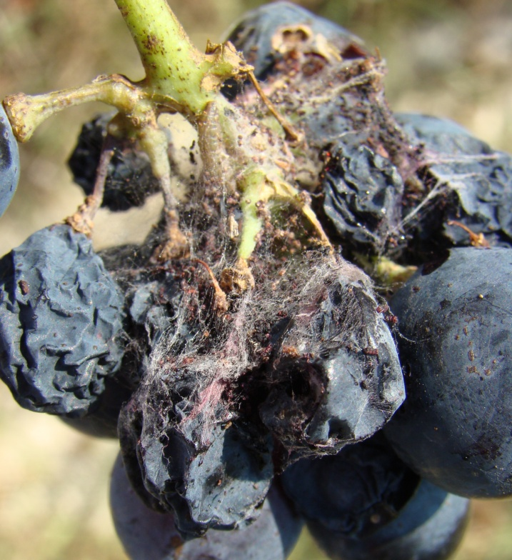
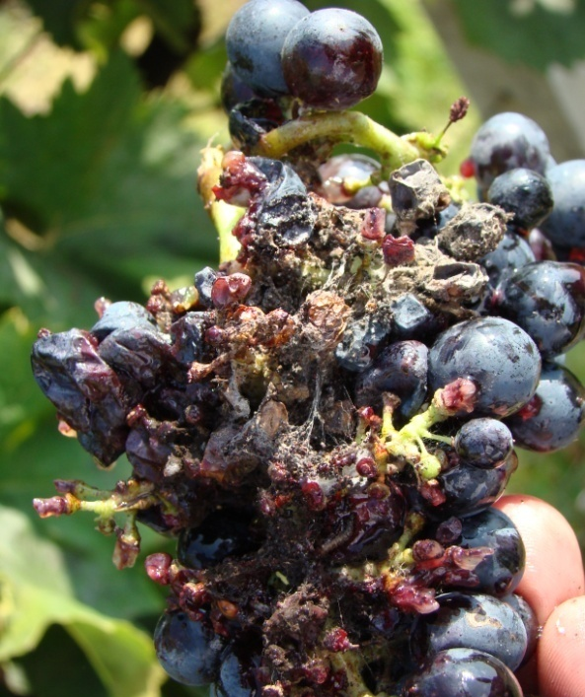
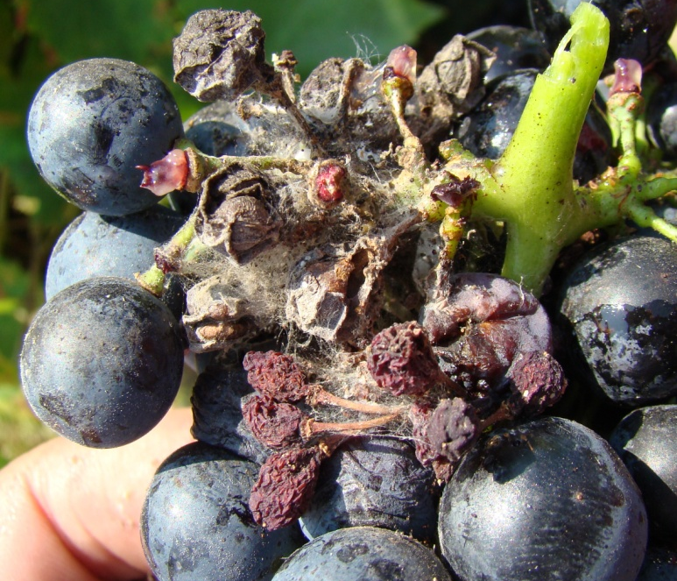
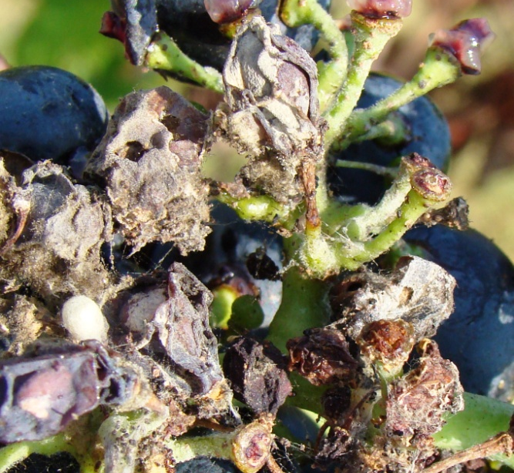
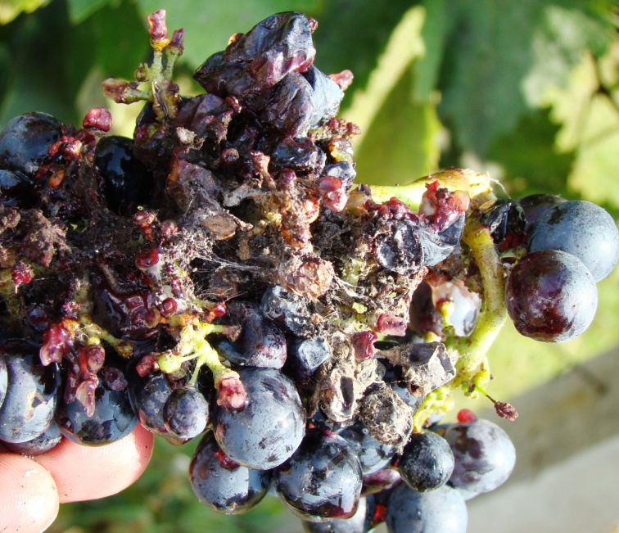

Slide 11

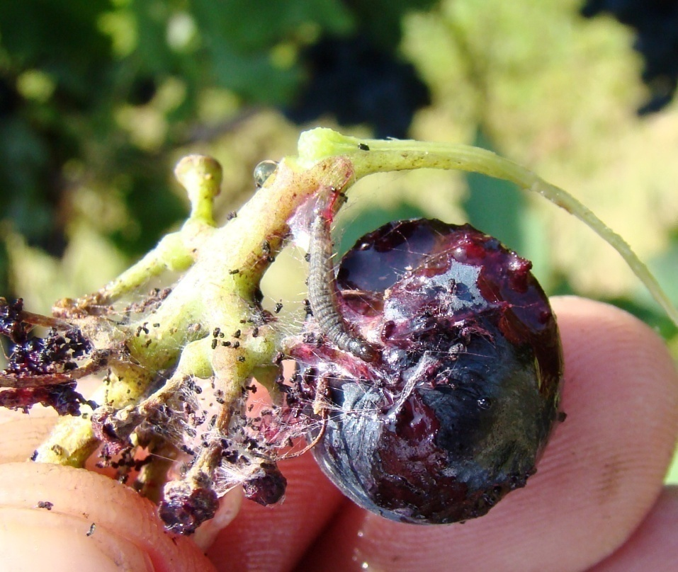
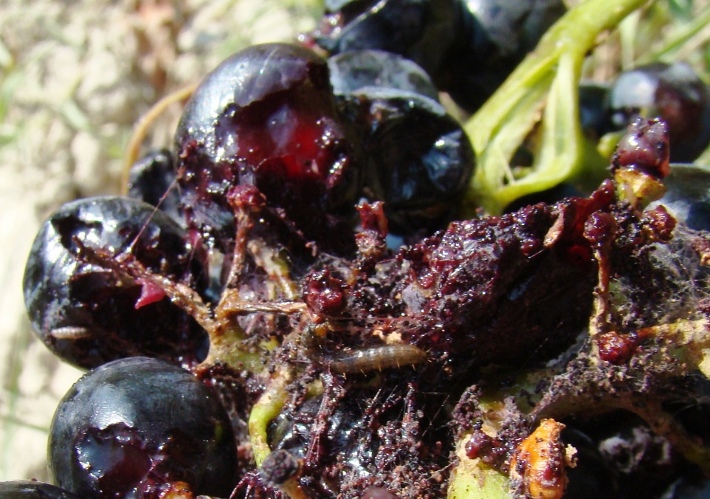

Slide 12
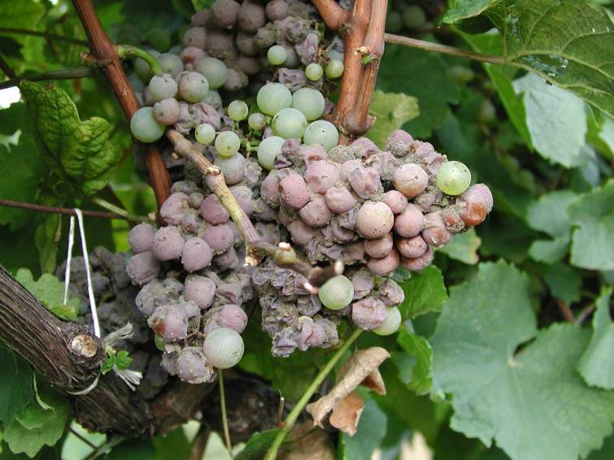
Indirect damage
The most significant losses – secundary infection by Botrytis cinerea

Slide 13
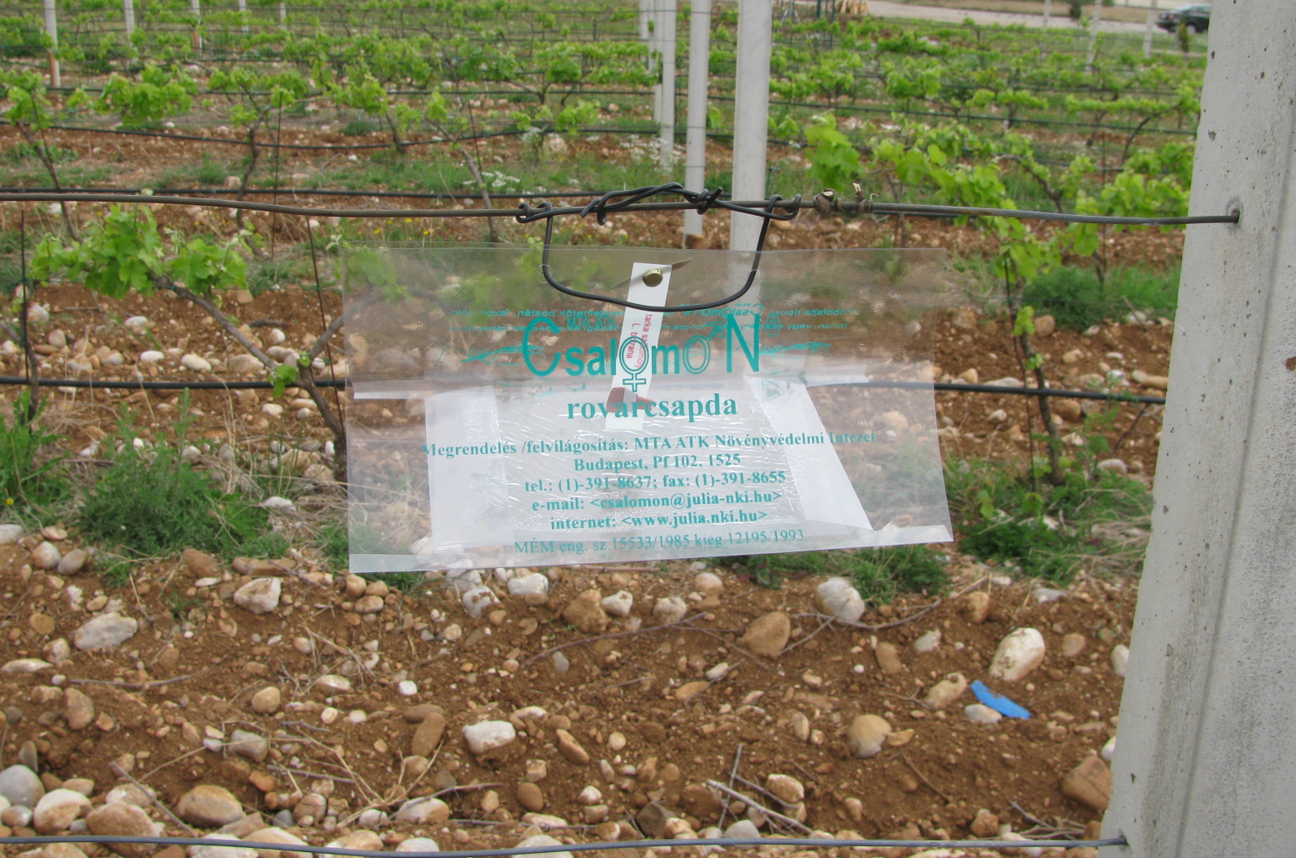
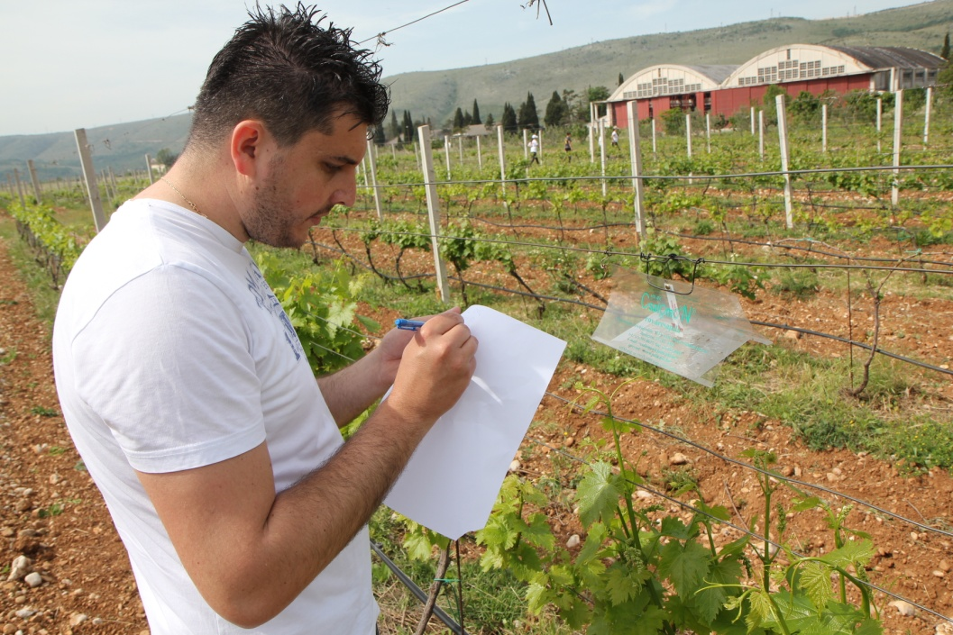
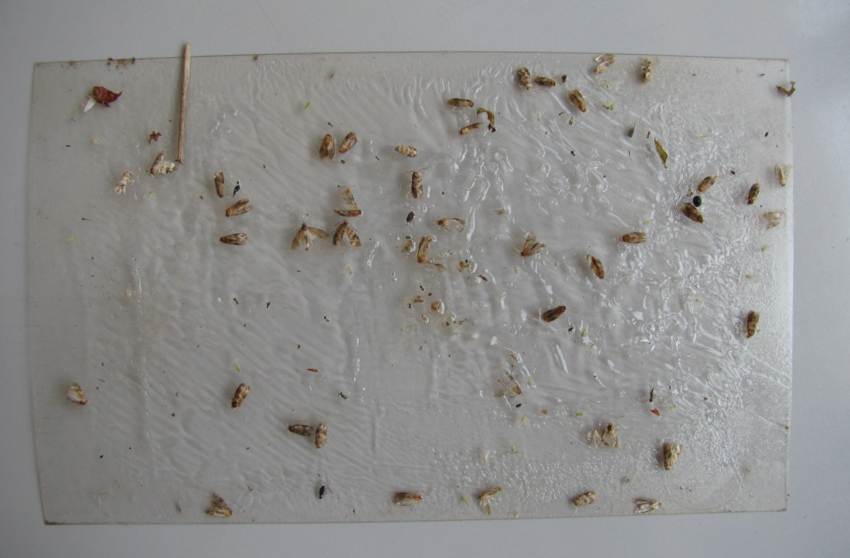
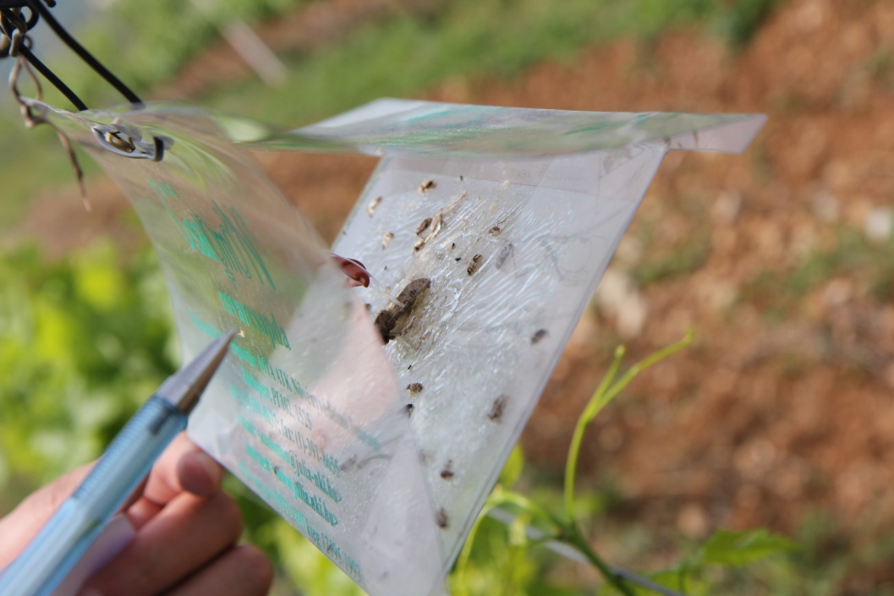
RAG trap
- most frequently used trap in B&H

Slide 14
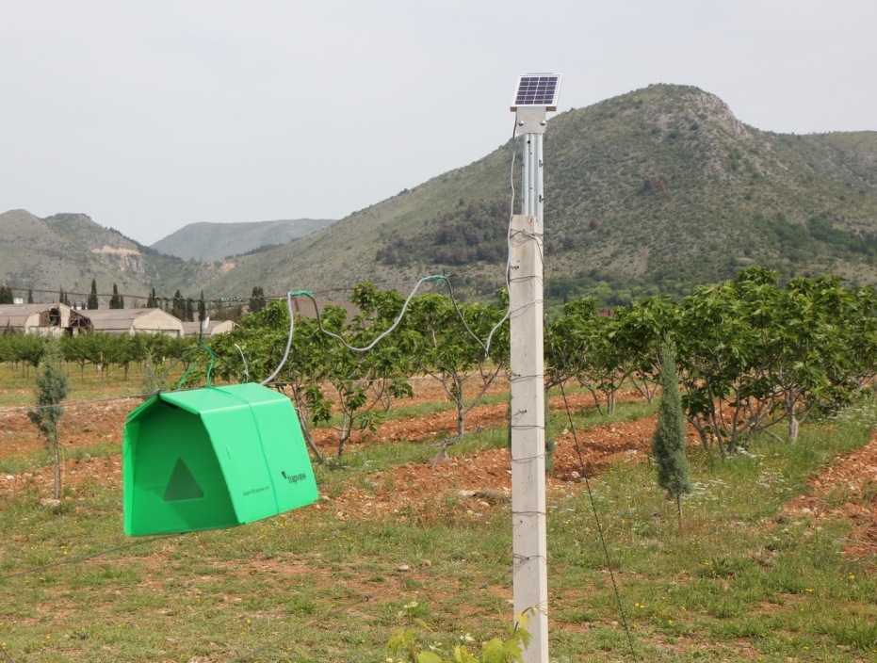
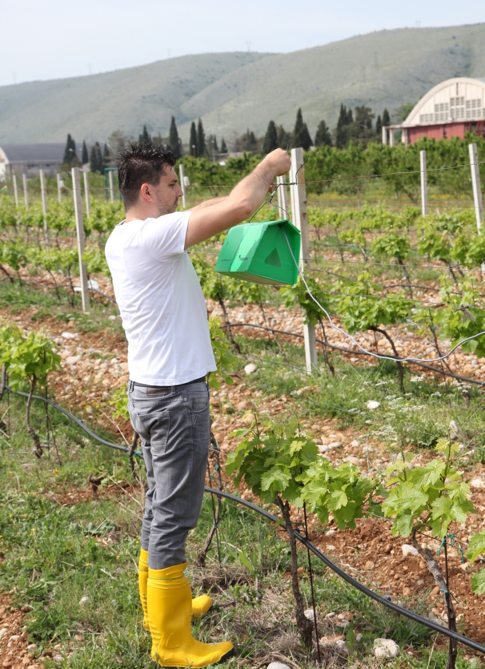
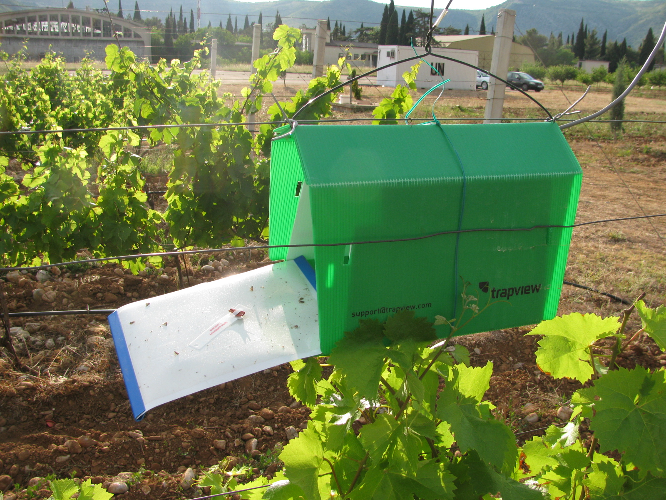
AUTOMATED PEST MONITORING SYSTEM

Slide 15
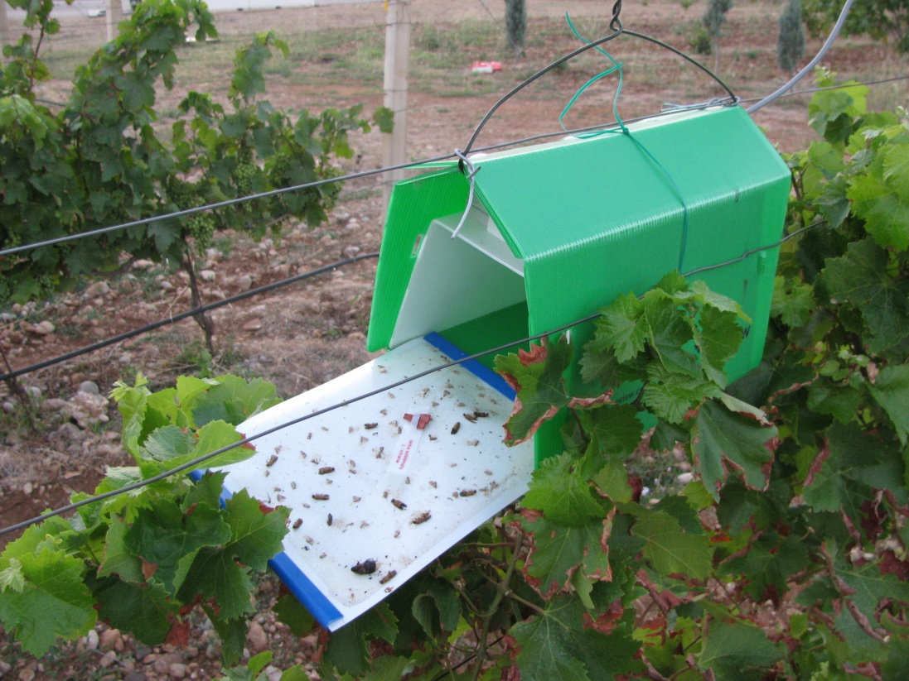
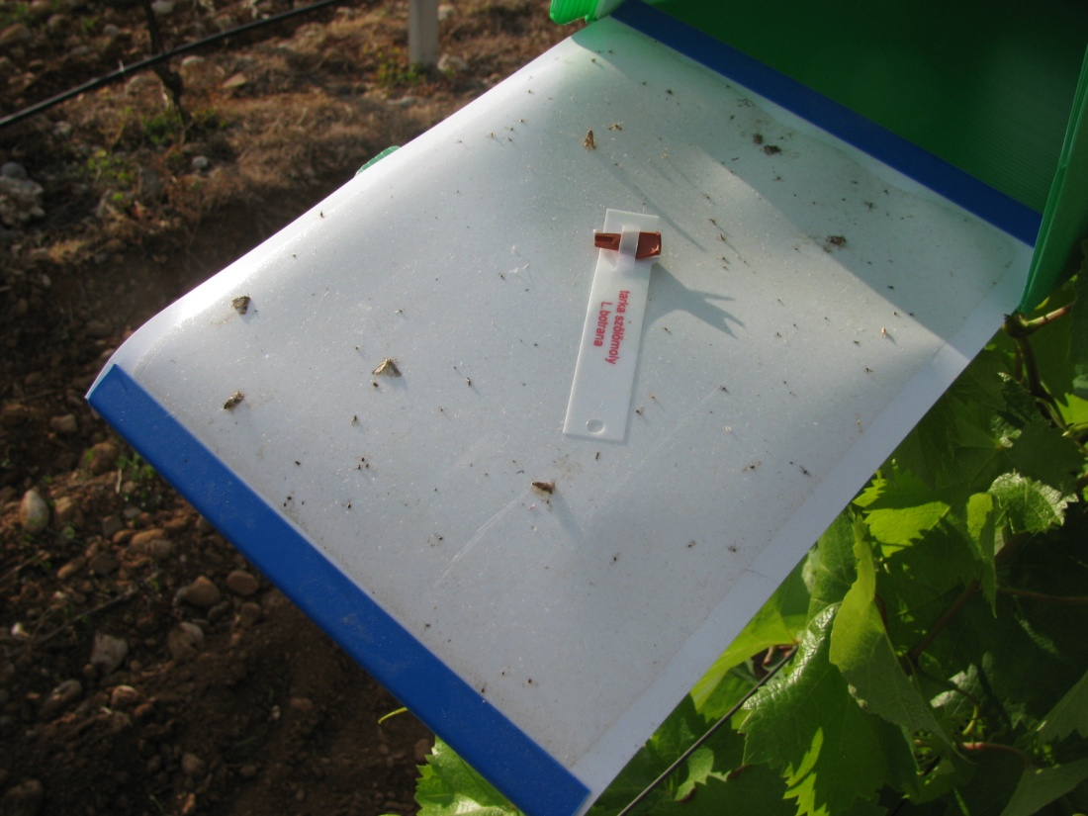
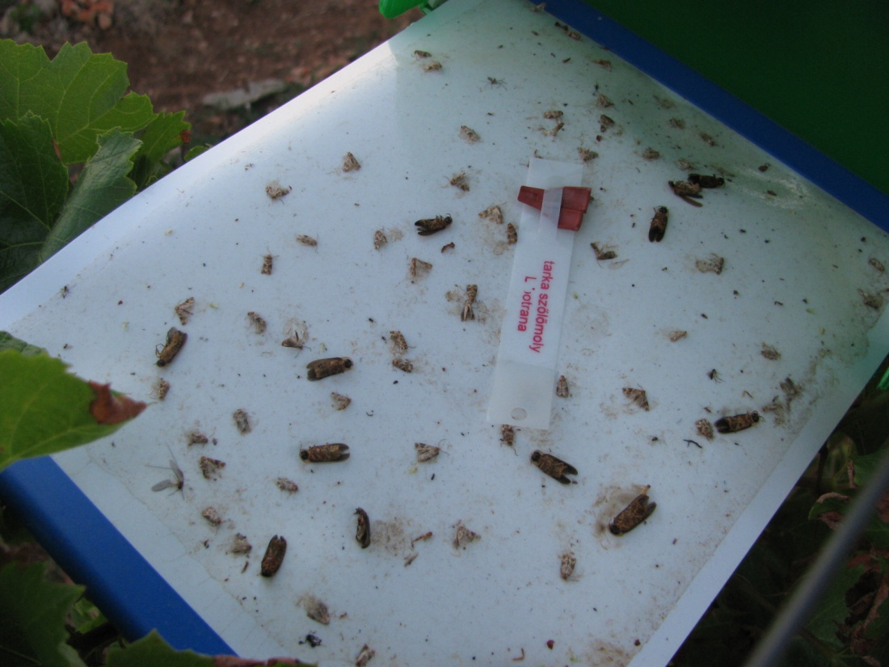
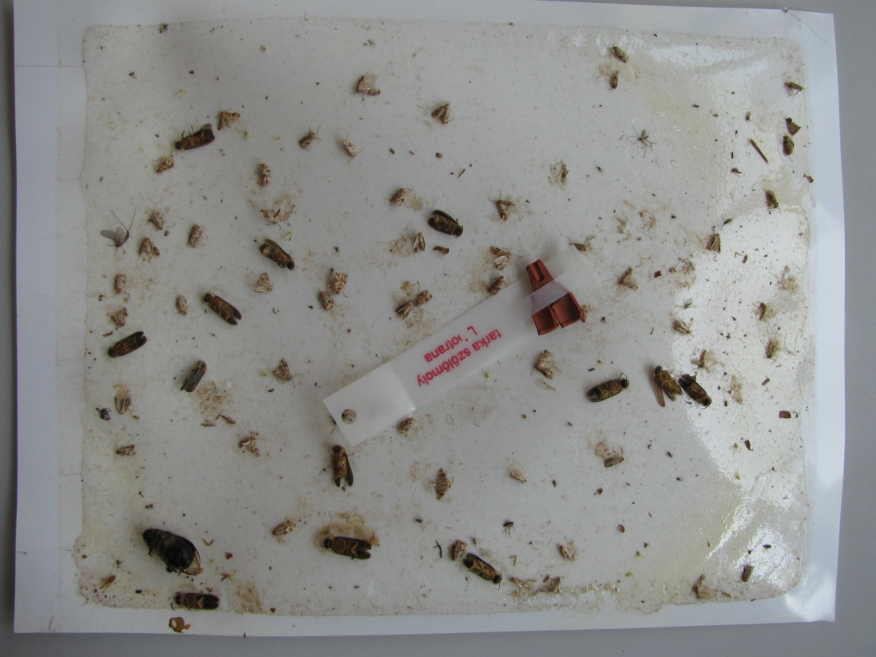
TRAPVIEW is an automated pest monitoring system that monitors all kinds of insects, which can be lured into insect traps.

Slide 16


Slide 17
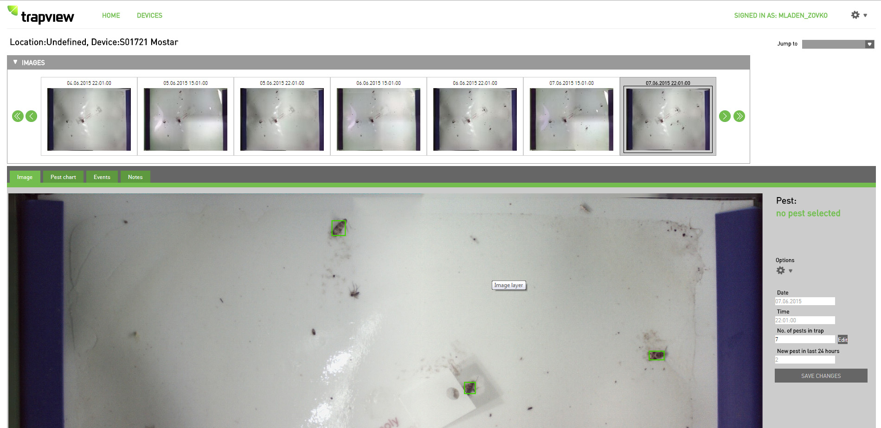
Web interface of TRAPWIEV application

Slide 18
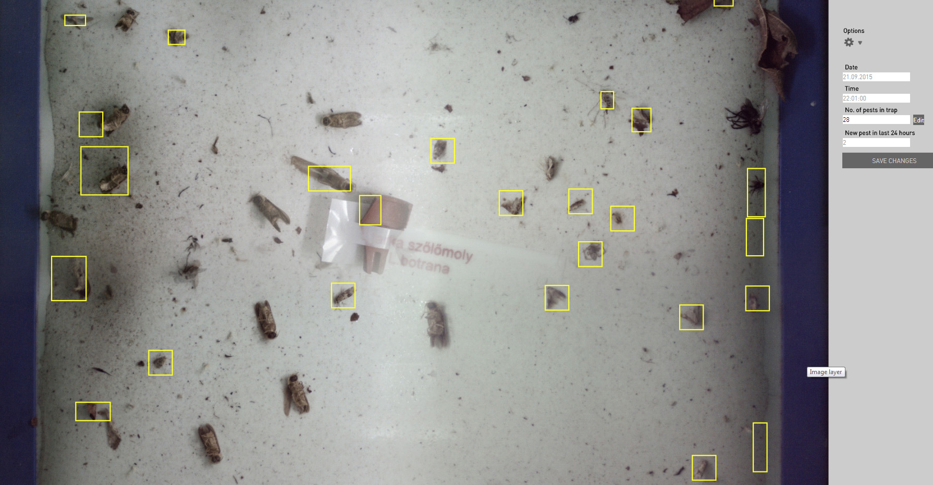
TRAPVIEW WEB application offers a detailed view of high resolution images taken from the trap and includes some analytical features for comparison of data over time.
Software for automated marking and counting of pests

Slide 19
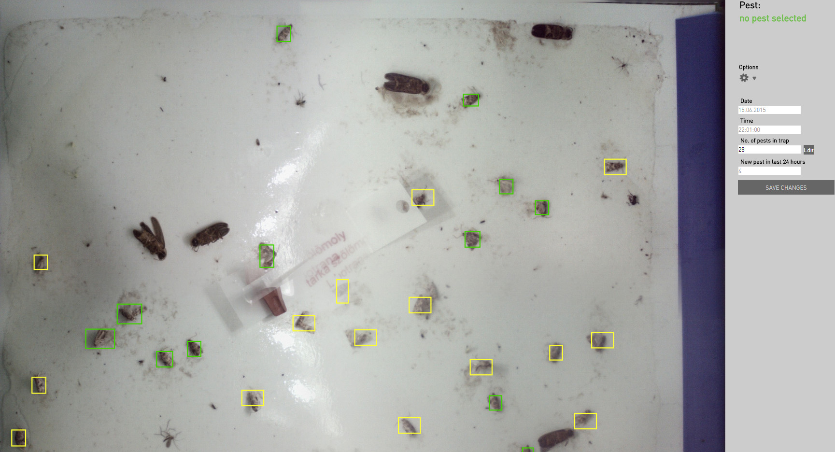

Slide 20
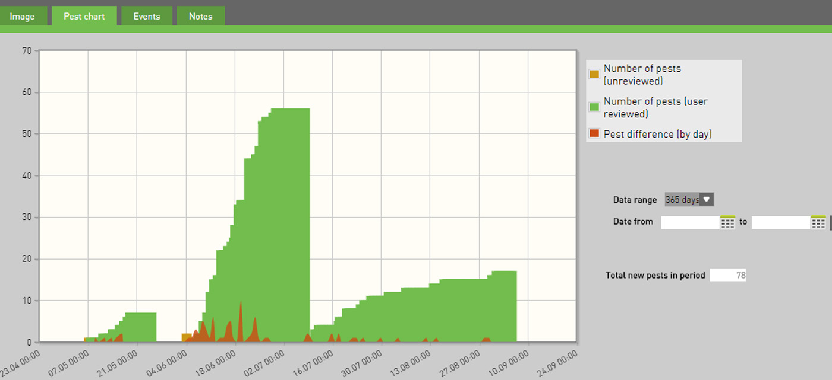

Slide 21
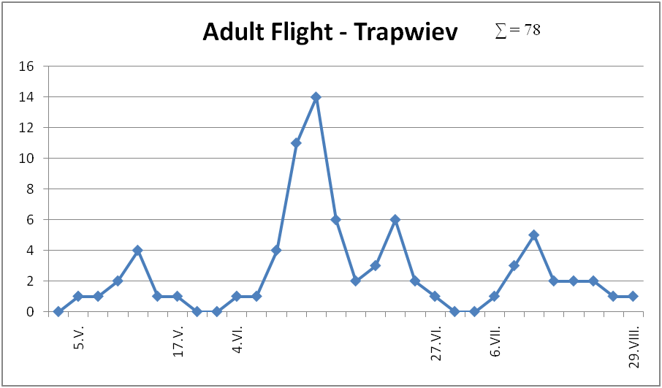
1st generation ∑ = 10
2nd generation ∑ = 51
3rd generation ∑ = 17

Slide 22
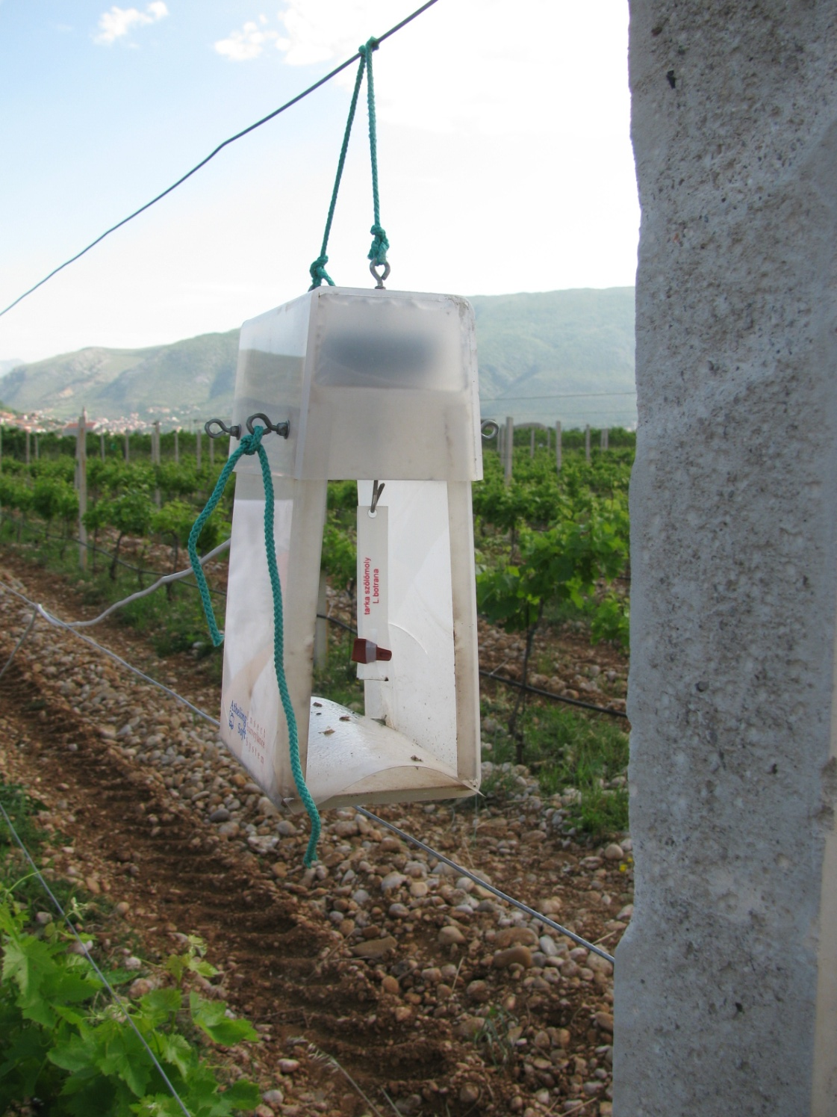
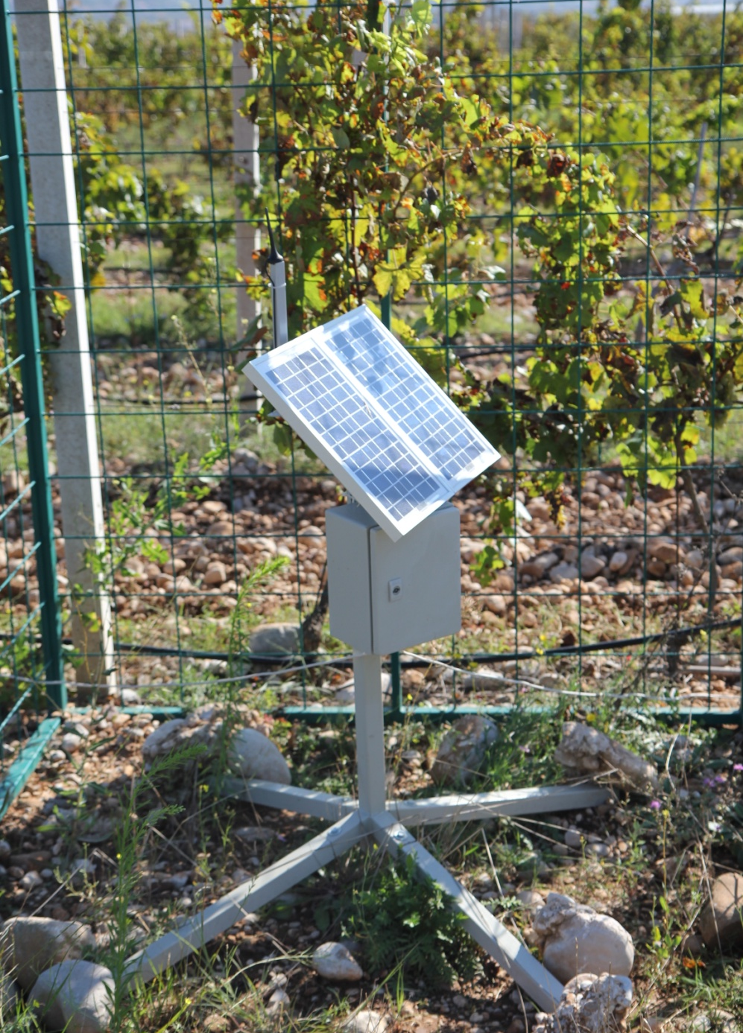
AS-ISS - trap

Slide 23
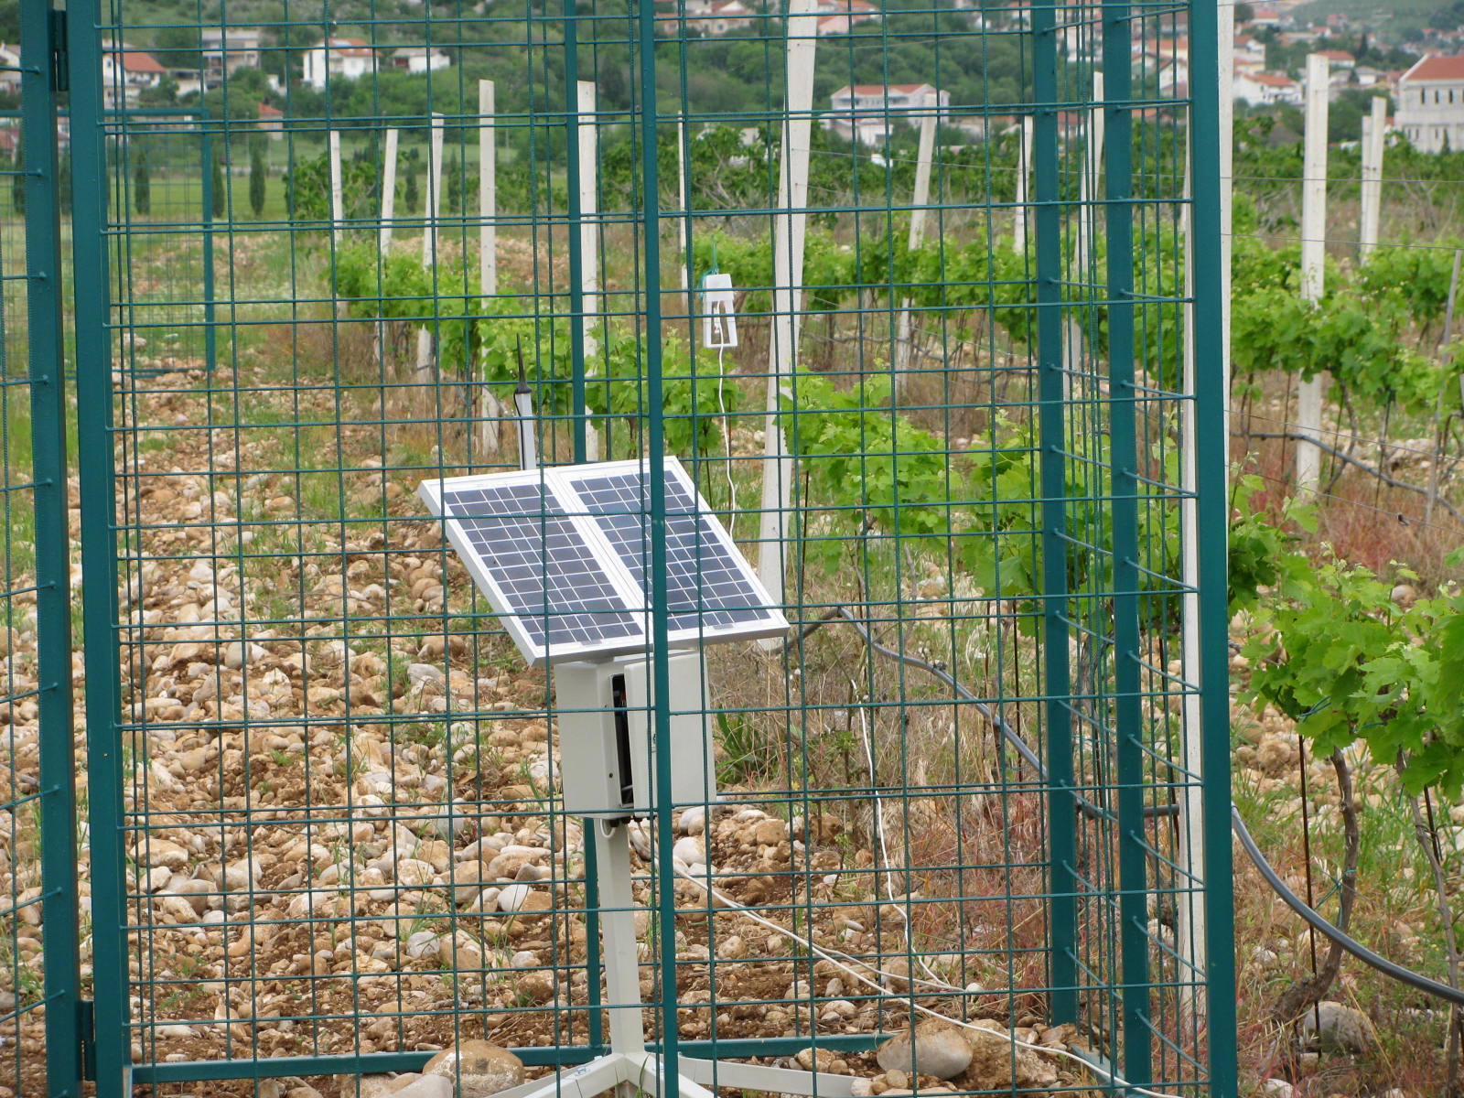

Slide 24
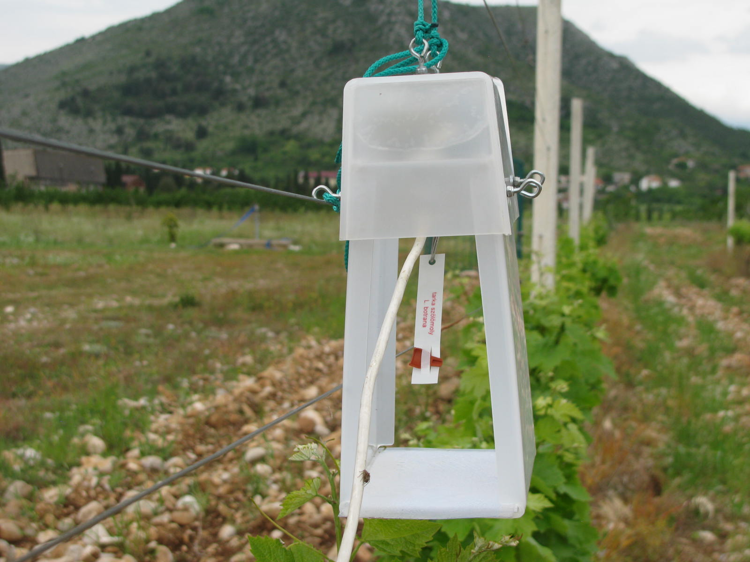
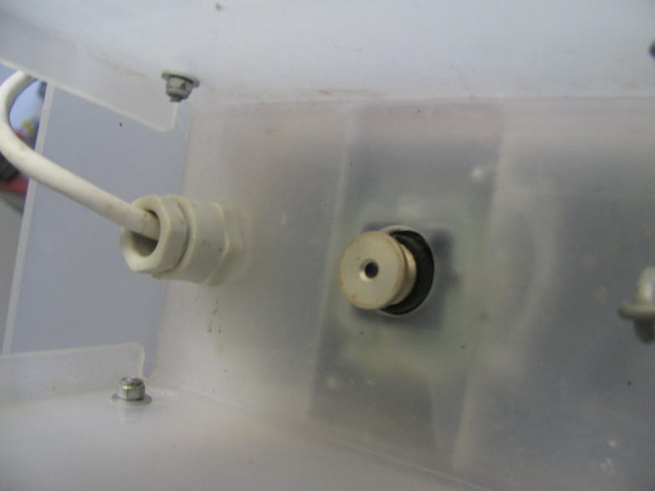

Slide 25
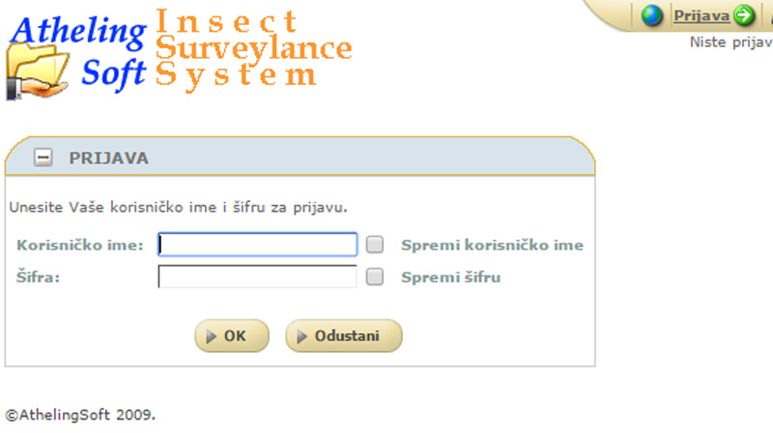
Web interface of AS-ISS application

Slide 26


Slide 27


Slide 28

1st generation ∑ = 6
2nd generation ∑ = 29
3rd generation ∑ = 13

Slide 29


Recommendation: Against first generation of grapevine moth use (Fastac 10 EC, Decis 2,5 EC, Karis MC)
1st – lambda-cihalotrin
EXTENSION
SERVICE
Warning: Application of insecticide against European grapevine moth is needed due to the its high occurrence in next 10 to 12 days
e-mail
GROWERS/PRODUCERS
2nd metoksifenozid
1st generation ∑ = 305
2nd generation ∑ = 169
3rd generation ∑ = 47

Slide 30
Warning: Application of insecticide against European grapevine moth is needed due to the its high occurrence of in next 10 days.
Recommendation: Against 2nd generation of grapevine moth use (Runner 240 SC, Mimic SC, Insegar 25 WP, Affirm SG )
e-mail
EXTENSION
SERVICE
GROWERS/PRODUCERS
2nd metoksifenozid
1st generation ∑ = 305
2nd generation ∑ = 169
3rd generation ∑ = 47

Slide 31

Prognostic models for plant diseases

Slide 32

Downy mildew of grapevines

Slide 33

Downy mildew of grapevines

Slide 34

Oilspot coused by Plasmopara viticola

Slide 35

Sporulation of Plasmopara viticola

Slide 36




Slide 37

2014.
Mjesec | Precipitation
April | 143,1 l/m²
May | 60,5 l/m²
June | 87,3 l/m²
July | 38,5 l/m²
August | 21,4 l/m²
September | 44,4 l/m²
∑ | 395,2 l/m²

Slide 38




Agriculture weather station - Pinova Meteo
Leaf wetness sensor

Slide 39

The basic model of Pinova Meteo station includes:
1. Temperature and relative humidity sensor (RHT35)
2. Rain gauge (RG300)
3. Leaf moisture sensor (PLWS)
4. Software for PC - PinovaSoft (desktop and web application)
5. Software for mobile phones - PinovaMobile
6. Stand
7. Solar panel
8. Batteries
Air Temperature (°C)
Relative air humidity (%)
Precipitation (mm/m2)
Leaf wetness (%)
Temperatures in the plant zone (°C)
Soil temperature (°C)
Wind speed (m/s)
Wind direction (0-360°)
Global Radiation (W/m2)
Photosynthetic activities (mol m-2s-1)
Air pressure (hPA)
Soil moisture (cb)
Dew Point (calculation) (°C)
Evapotranspiration (Eto) (calculation) (mm/m2)
Maximum number of sensors per station: 8

Slide 40

Disease models
Growth and development of plant pathogens (fungi, bacteria) depend mostly on weather conditions. The main parameters that agriculture weather station have to measure to predict or to say when was infection is air temperature, relative air humidity, moisture content on leaf and precipitation.

Slide 41



Slide 42




Pinova mobile

Slide 43




Pinova mobile
Total precipitation - Rodoč (Mostar)

Slide 44




Slide 45

Development of plant diseases

Slide 46

Development of plant diseases – Downy mildew (Plasmopara viticola)
1st - 04.V.
cizofamid
2nd - 20.V.
metalaksil-M
3rd - 17.VI.
metalaksil-M

Slide 47

Development of plant diseases – Downy mildew (Plasmopara viticola)
4th - 25.VII.
mandipropamid
5th - 19.VIII.
ciazofamid

Slide 48

Temperature thresholds and thermal requirements for the development
of plant diseases/insect pests
Temperature sums or degree days are a measurement that reflects on the accumulated heat above a specific temperature threshold in a particular period.
Example
Temperature sums are used to determine the maturity of oospores in grape vines. It is considered that oospores are mature when the sum is 160 to 170 °C since the beginning of the calendar year with the temperature threshold of 8 °C.

Slide 49

Example
A study that was carried out in Turkey used sum of temperatures to determinate presence of grapevine moth. Results have shown that the first generation appeared around the accumulated 120 °C, the second generation around 520 °C and the third generation around 1047 °C.

